Slide 1

IN432
Advanced Web Programming

Slide 2
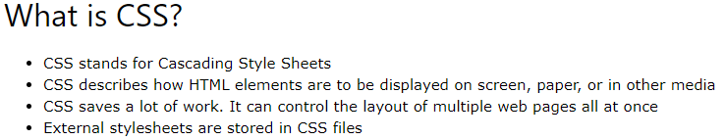
CSS – Cascading Style Sheets

Slide 3
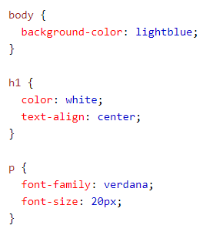
CSS – Cascading Style Sheets
Why Use CSS?
CSS is used to define styles for your web pages, including the design, layout and variations in display for different devices and screen sizes.

Slide 4
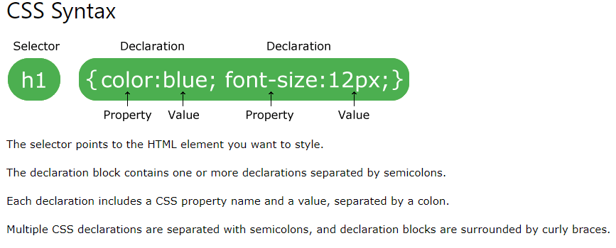

Slide 5
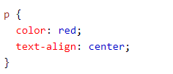
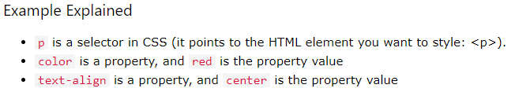

Slide 6
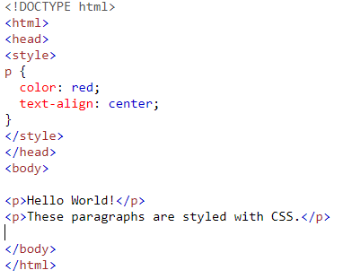

Slide 7
CSS Selectors
CSS selectors are used to "find" (or select) the HTML elements you want to style.

Slide 8
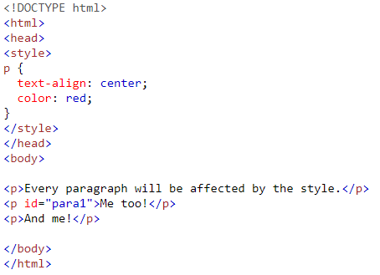
CSS Selectors
Simple selectors (select elements based on name, id, class)

Slide 9
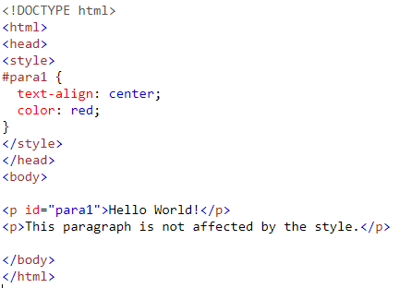
CSS Selectors
Simple selectors (select elements based on name, id, class)
The CSS id Selector

Slide 10
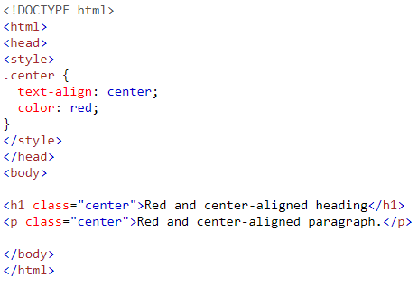
CSS Selectors
Simple selectors (select elements based on name, id, class)
The CSS class Selector

Slide 11
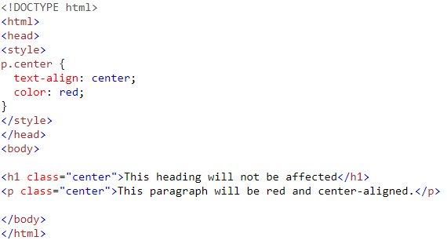

CSS Selectors
Simple selectors (select elements based on name, id, class)
The CSS class Selector

Slide 12
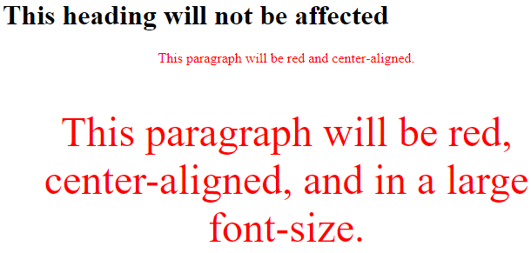
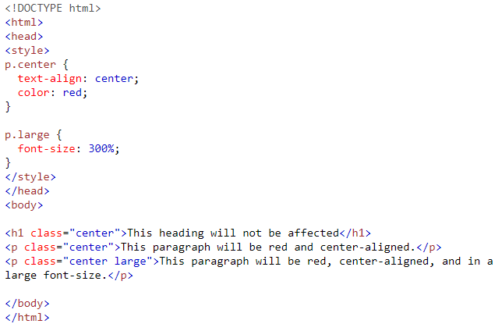
CSS Selectors
Simple selectors (select elements based on name, id, class)
The CSS class Selector

Slide 13
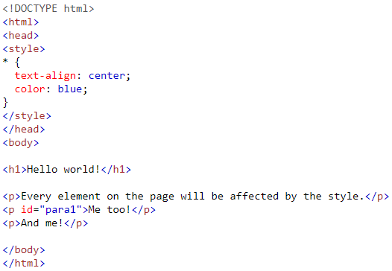
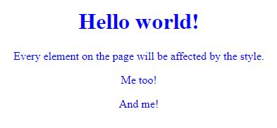
CSS Selectors
Simple selectors (select elements based on name, id, class)
The CSS universal Selector

Slide 14
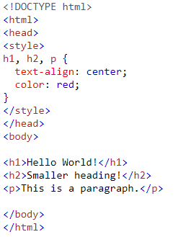
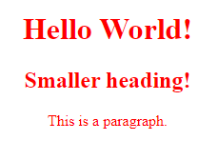
CSS Selectors
Simple selectors (select elements based on name, id, class)
The CSS Grouping Selector

Slide 15
How To Add CSS
There are three ways of inserting a style sheet:
External CSS
Internal CSS
Inline CSS

Slide 16

How To Add CSS
External CSS
With an external style sheet, you can change the look of an entire website by changing just one file!
Each HTML page must include a reference to the external style sheet file inside the <link> element, inside the head section.
External styles are defined within the <link> element, inside the <head> section of an HTML page:

Slide 17

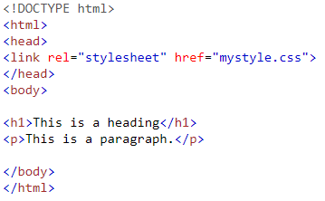
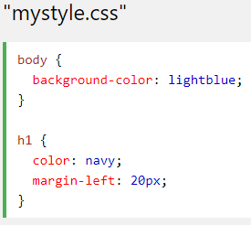
How To Add CSS
External CSS
Note: Do not add a space between the property value and the unit (such as margin-left: 20 px;). The correct way is: margin-left: 20px;

Slide 18
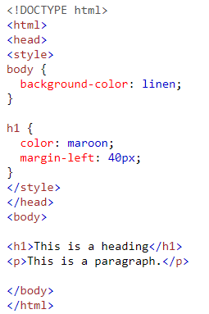

How To Add CSS
Internal CSS

Slide 19
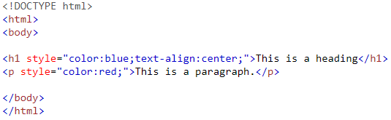
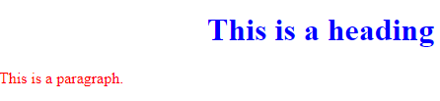
How To Add CSS
Inline CSS
An inline style may be used to apply a unique style for a single element.
To use inline styles, add the style attribute to the relevant element.
The style attribute can contain any CSS property.

Slide 20
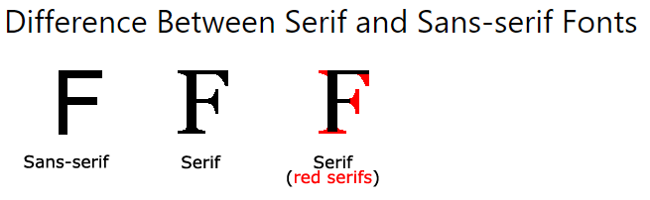
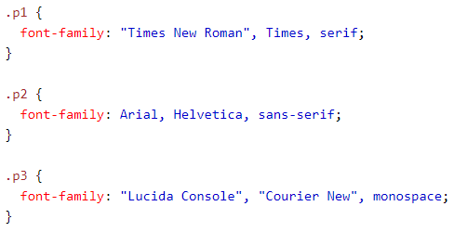
CSS Font
The CSS font-family Property

Slide 21
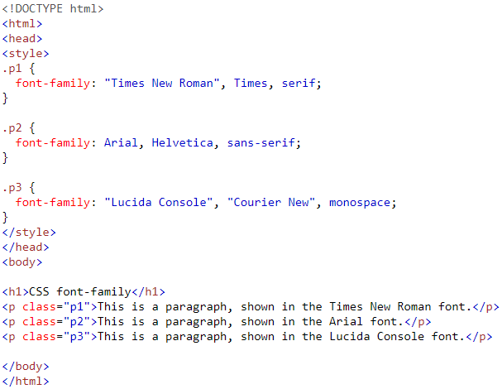
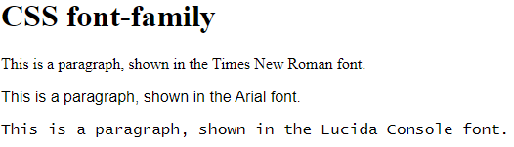
CSS Font
The CSS font-family Property

Slide 22
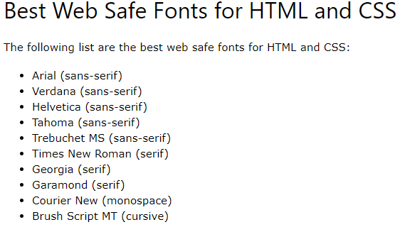
CSS Font
CSS Web Safe Fonts
Web safe fonts are fonts that are universally installed across all browsers and devices.
Note: Before you publish your website, always check how your fonts appear on different browsers and devices, and always use fallback fonts!

Slide 23
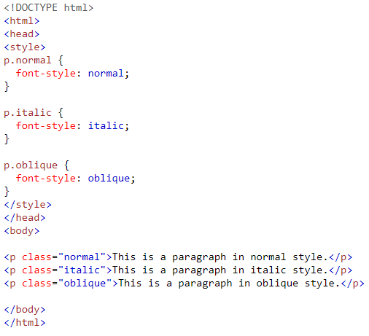

CSS Font
Font Style

Slide 24
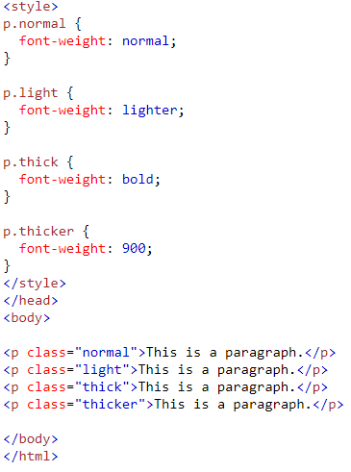
CSS Font
Font Weight

Slide 25
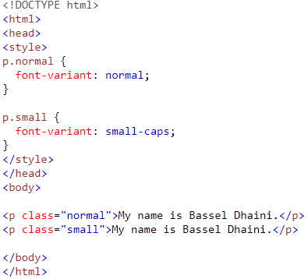

CSS Font
Font Variant
The font-variant property specifies whether or not a text should be displayed in a small-caps font.

Slide 26
CSS Font
Font Size
Set Font Size With Pixels
Set Font Size With Em
h1 {
font-size: 40px;
}
h2 {
font-size: 30px;
}
p {
font-size: 14px;
}
h1 {
font-size: 2.5em; /* 40px/16=2.5em */
}
h2 {
font-size: 1.875em; /* 30px/16=1.875em */
}
p {
font-size: 0.875em; /* 14px/16=0.875em */
}
To allow users to resize the text (in the browser menu), many developers use em instead of pixels.
1em is equal to the current font size. The default text size in browsers is 16px. So, the default size of 1em is 16px.
The size can be calculated from pixels to em using this formula: pixels/16=em

